Slide 1
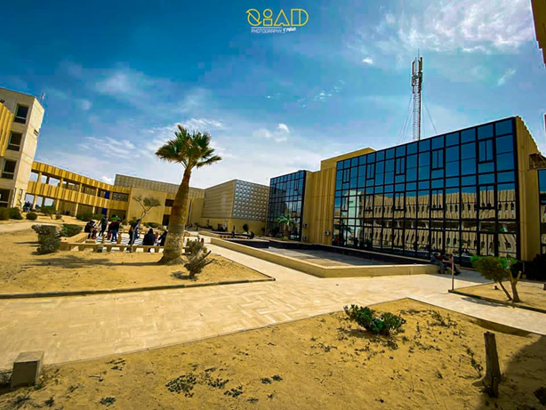

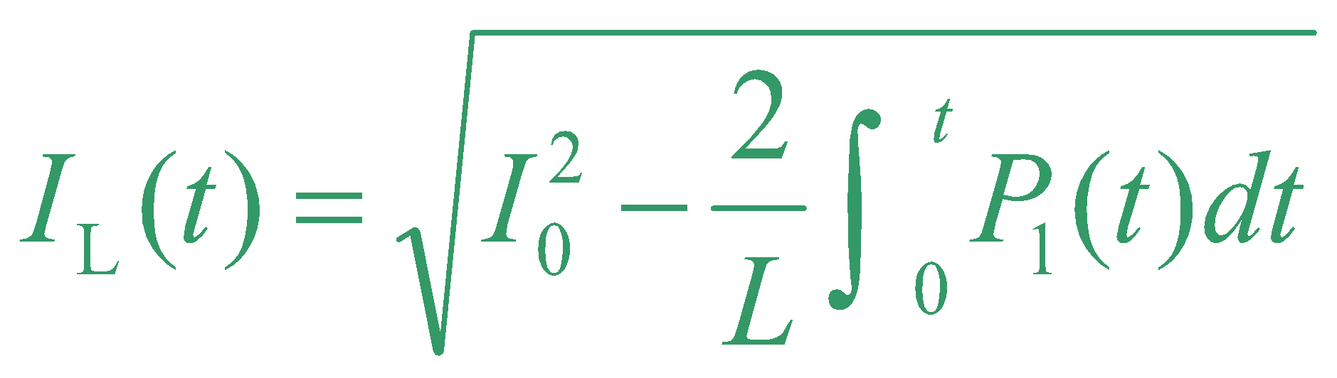
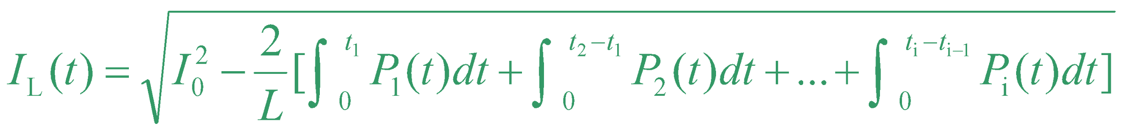
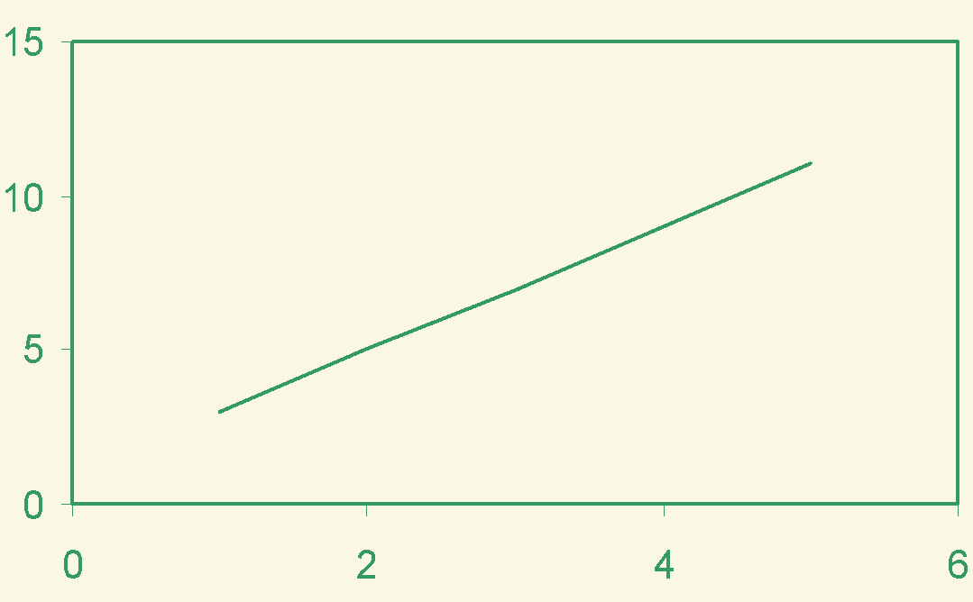
The Title of the Paper in International Aviation Sciences Conference (1ST IASC 2025) (30 point font, bold letters)
ID: IASC 2025
Names of the Authors (24 point font, bold letters, one line only)
Authors’ Affiliation(s) (20 point font, one line only)
Abstract (22 point font, bold letters)
All poster papers submitted to the 1st IASC 2025 must be presented in the specified format. Please use this document as a template to form the poster in which you can type your own text. (17 point font, single-spaced) and paste figures.
Keywords (22 point font, bold letters)
1st IASC 2025 ; Libya; Bright Star University. (one line if possible)
IV. Experiments
The International Aviation Sciences Conference (1ST IASC 2025) will be held from 14 to 15 May 2025 in Libya. IASC 2025 is cosponsored by Bright Star University, Elbrega, Libya.
I. Introduction (22 point font, bold letters )
This is the template for preparation of posters for the International Aviation Sciences Conference (1ST IASC 2025) . Please use this document as a sample of the conference poster.
IASC 2025 will produce final hard copies of all poster papers in a unified style. The PowerPoint template to produce your conference posters is available at
https://bsu.edu.ly/?page_id=8125
All the poster papers accepted MUST be presented in the specified format . Once you have finished using this template to prepare your poster and have followed the guidelines for poster presentations, which will be attached in word form, kindly email: icas@bsu.edu.ly
II. Principle (22 point font, bold letters )
Describe the basic principle of your research works here.
The scope of the conference includes principally the following topics:
Track 1:Aeronautical and Aerospace Engineering
Track 2: Roads and Airports Engineering
Fig. 3. Bright Star University, Libya.
III. Methods
This is the template for preparation of posters for IASC 2025. Please use this
document as a sample of the conference poster.
V. Results and Analyses
Results: Briefly provide descriptive results. Present data that more specifically addresses the hypothesis and refer to supporting charts or images. Tables and graphs should stand on their own.
A. Template of Font (20 point font)
All the items in your poster should be presented as an uniform layout. Do NOT
change the font sizes and font colors in the template.
Move the mouse to the beginning of the last column of each paragraph, press the key of “Enter” to interrupt the last column, and then make it LEFT align.
Other columns in each paragraph are recommended to be JUSTIFY align.
B. Template of Figures and Tables
More Figures and Tables are preferred for your poster to present your
outstanding works in IASC 2025.
Try to make your Figures are transparent to suit the light-yellow
background of the poster. In addition, all the items in the Figures and Tables such as lines, words, symbols are recommended to be identical to the colour of the
TEXT in the template (dark green)
(1)
(2)
Fig. 4. Title of the Figure. (16 point font)
VI. Conclusion
Conclusion and recommendations: Comment on main results and discuss why they are conclusive and interesting. Discuss potential biases. What are your recommendations?
(Detailed information will be updated later)
Fig. 1. Title of the Figure. (16 point font)
Fig. 2. Title of the Figure. (16 point font)
Table I. Heading of the Table. (16 point font)
Model | Feature extraction | Reprocessing | Classification
KNN | >200,000 flops | ~10 flops | ~200 flops
NN |  |  | ~10,000 flops
References (Optional)
[1] X.Y. Cole, Enter main references here, IASC’ 2025, May. 14-15, 2025.
.
• Enter your acknowledgements or sponsors here. (Optional) (14 point font)
Author email: XXX@XX.XX
International Aviation Sciences Conference (1ST IASC 2025)

